Slide 1

Introduction to Operating Systems CS/COE 1550
Spring 2022
Sherif Khattab
ksm73@pitt.edu
(Some slides are from Silberschatz, Galvin and Gagne ©2013)

Slide 2
Announcements
Upcoming deadlines:
Quiz 1 and Homework 4: due 10/8
Lab 2: due on 10/18
Project 2: due on 10/22

Slide 3
Last Lecture …
Monitors and Condition Variables
How to use
How to implement (user-level implementation of Hoare semantics)

Slide 4
Muddiest Points

Slide 5
Today …
Other synchronization mechanisms
Classical Process Synchronization Problems
Semaphore-based solutions

Slide 6
Condition variables in monitors
Problem: how can a process wait inside a monitor?
Can’t simply sleep: there’s no way for anyone else to enter
Solution: use a condition variable
Condition variables support two operations
Wait(): suspend this process until signaled
Signal(): wake up exactly one process waiting on this condition variable
If no process is waiting, signal has no effect
Signals on condition variables aren’t “saved up”
Different from semaphores!
Condition variables are only usable within monitors
Process must be in monitor to signal on a condition variable

Slide 7
Locks & condition variables
Monitors require native language support
What if native support is not there (e.g., in C)?
Provide monitor support using special data types and procedures
Locks (Acquire(), Release())
Condition variables (Wait(), Signal())
Lock usage
Acquiring a lock == entering a monitor
Releasing a lock == leaving a monitor
Condition variable usage
Each condition variable is associated with exactly one lock
Lock must be held to use condition variable
Waiting on a condition variable releases the lock implicitly and reacquires the lock upon returning

Slide 8
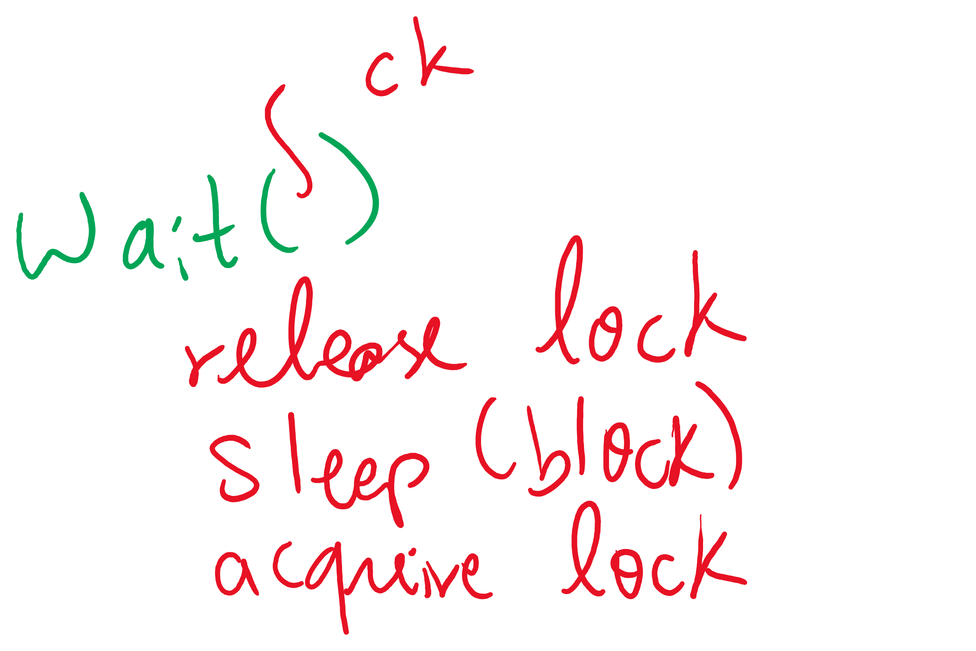


The three steps of the wait() operation

Slide 9
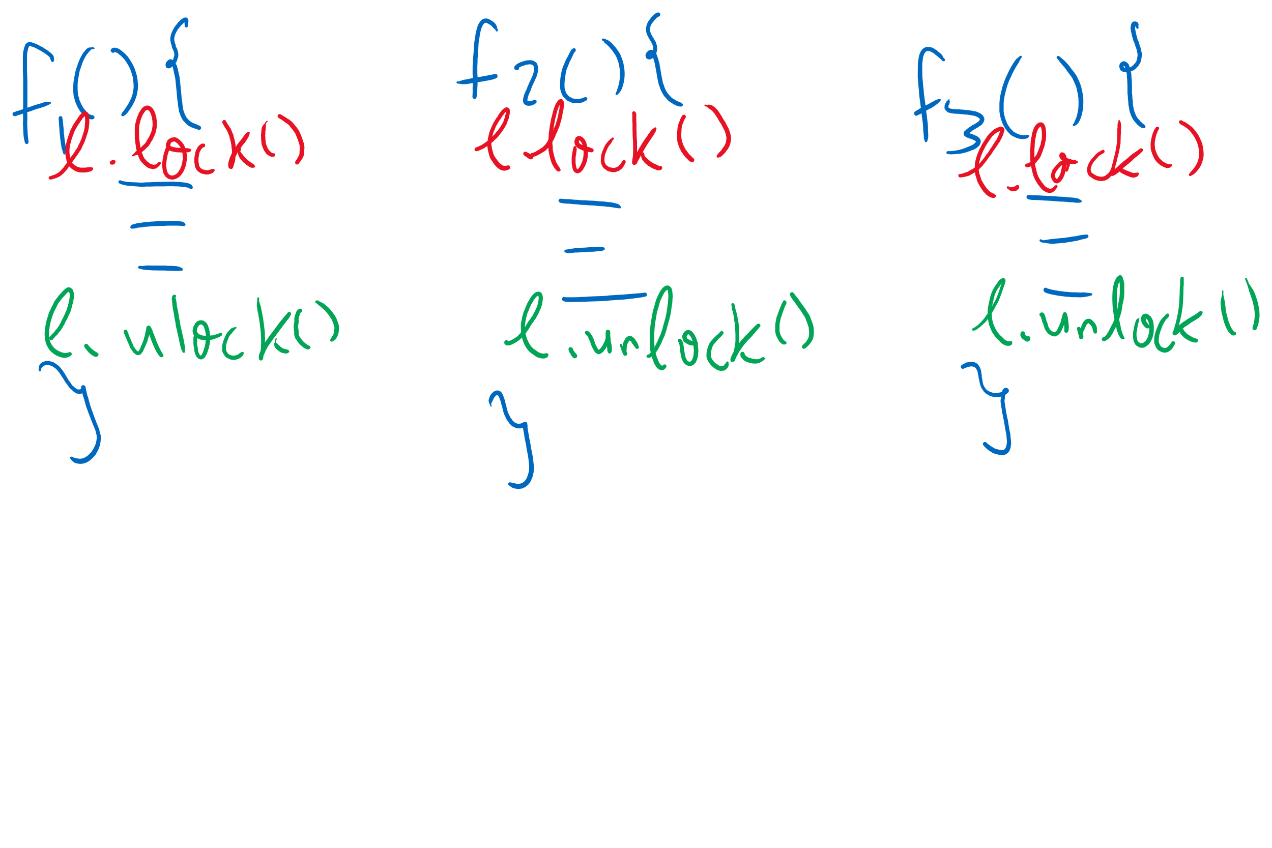
Adding Monitors in C

Slide 10
Monitor semantics
Question: which process gets the monitor after Signal()?
Problem: P signals on condition variable X, waking Q
Both can’t be active in the monitor at the same time
Which one continues first?
Mesa semantics
Signaling process (P) continues first
Q resumes when P leaves the monitor
Seems more logical: why suspend P when it signals?
Hoare semantics
Awakened process (Q) continues first
P resumes when Q leaves the monitor
May be better: condition that Q wanted may no longer hold when P leaves the monitor

Slide 11
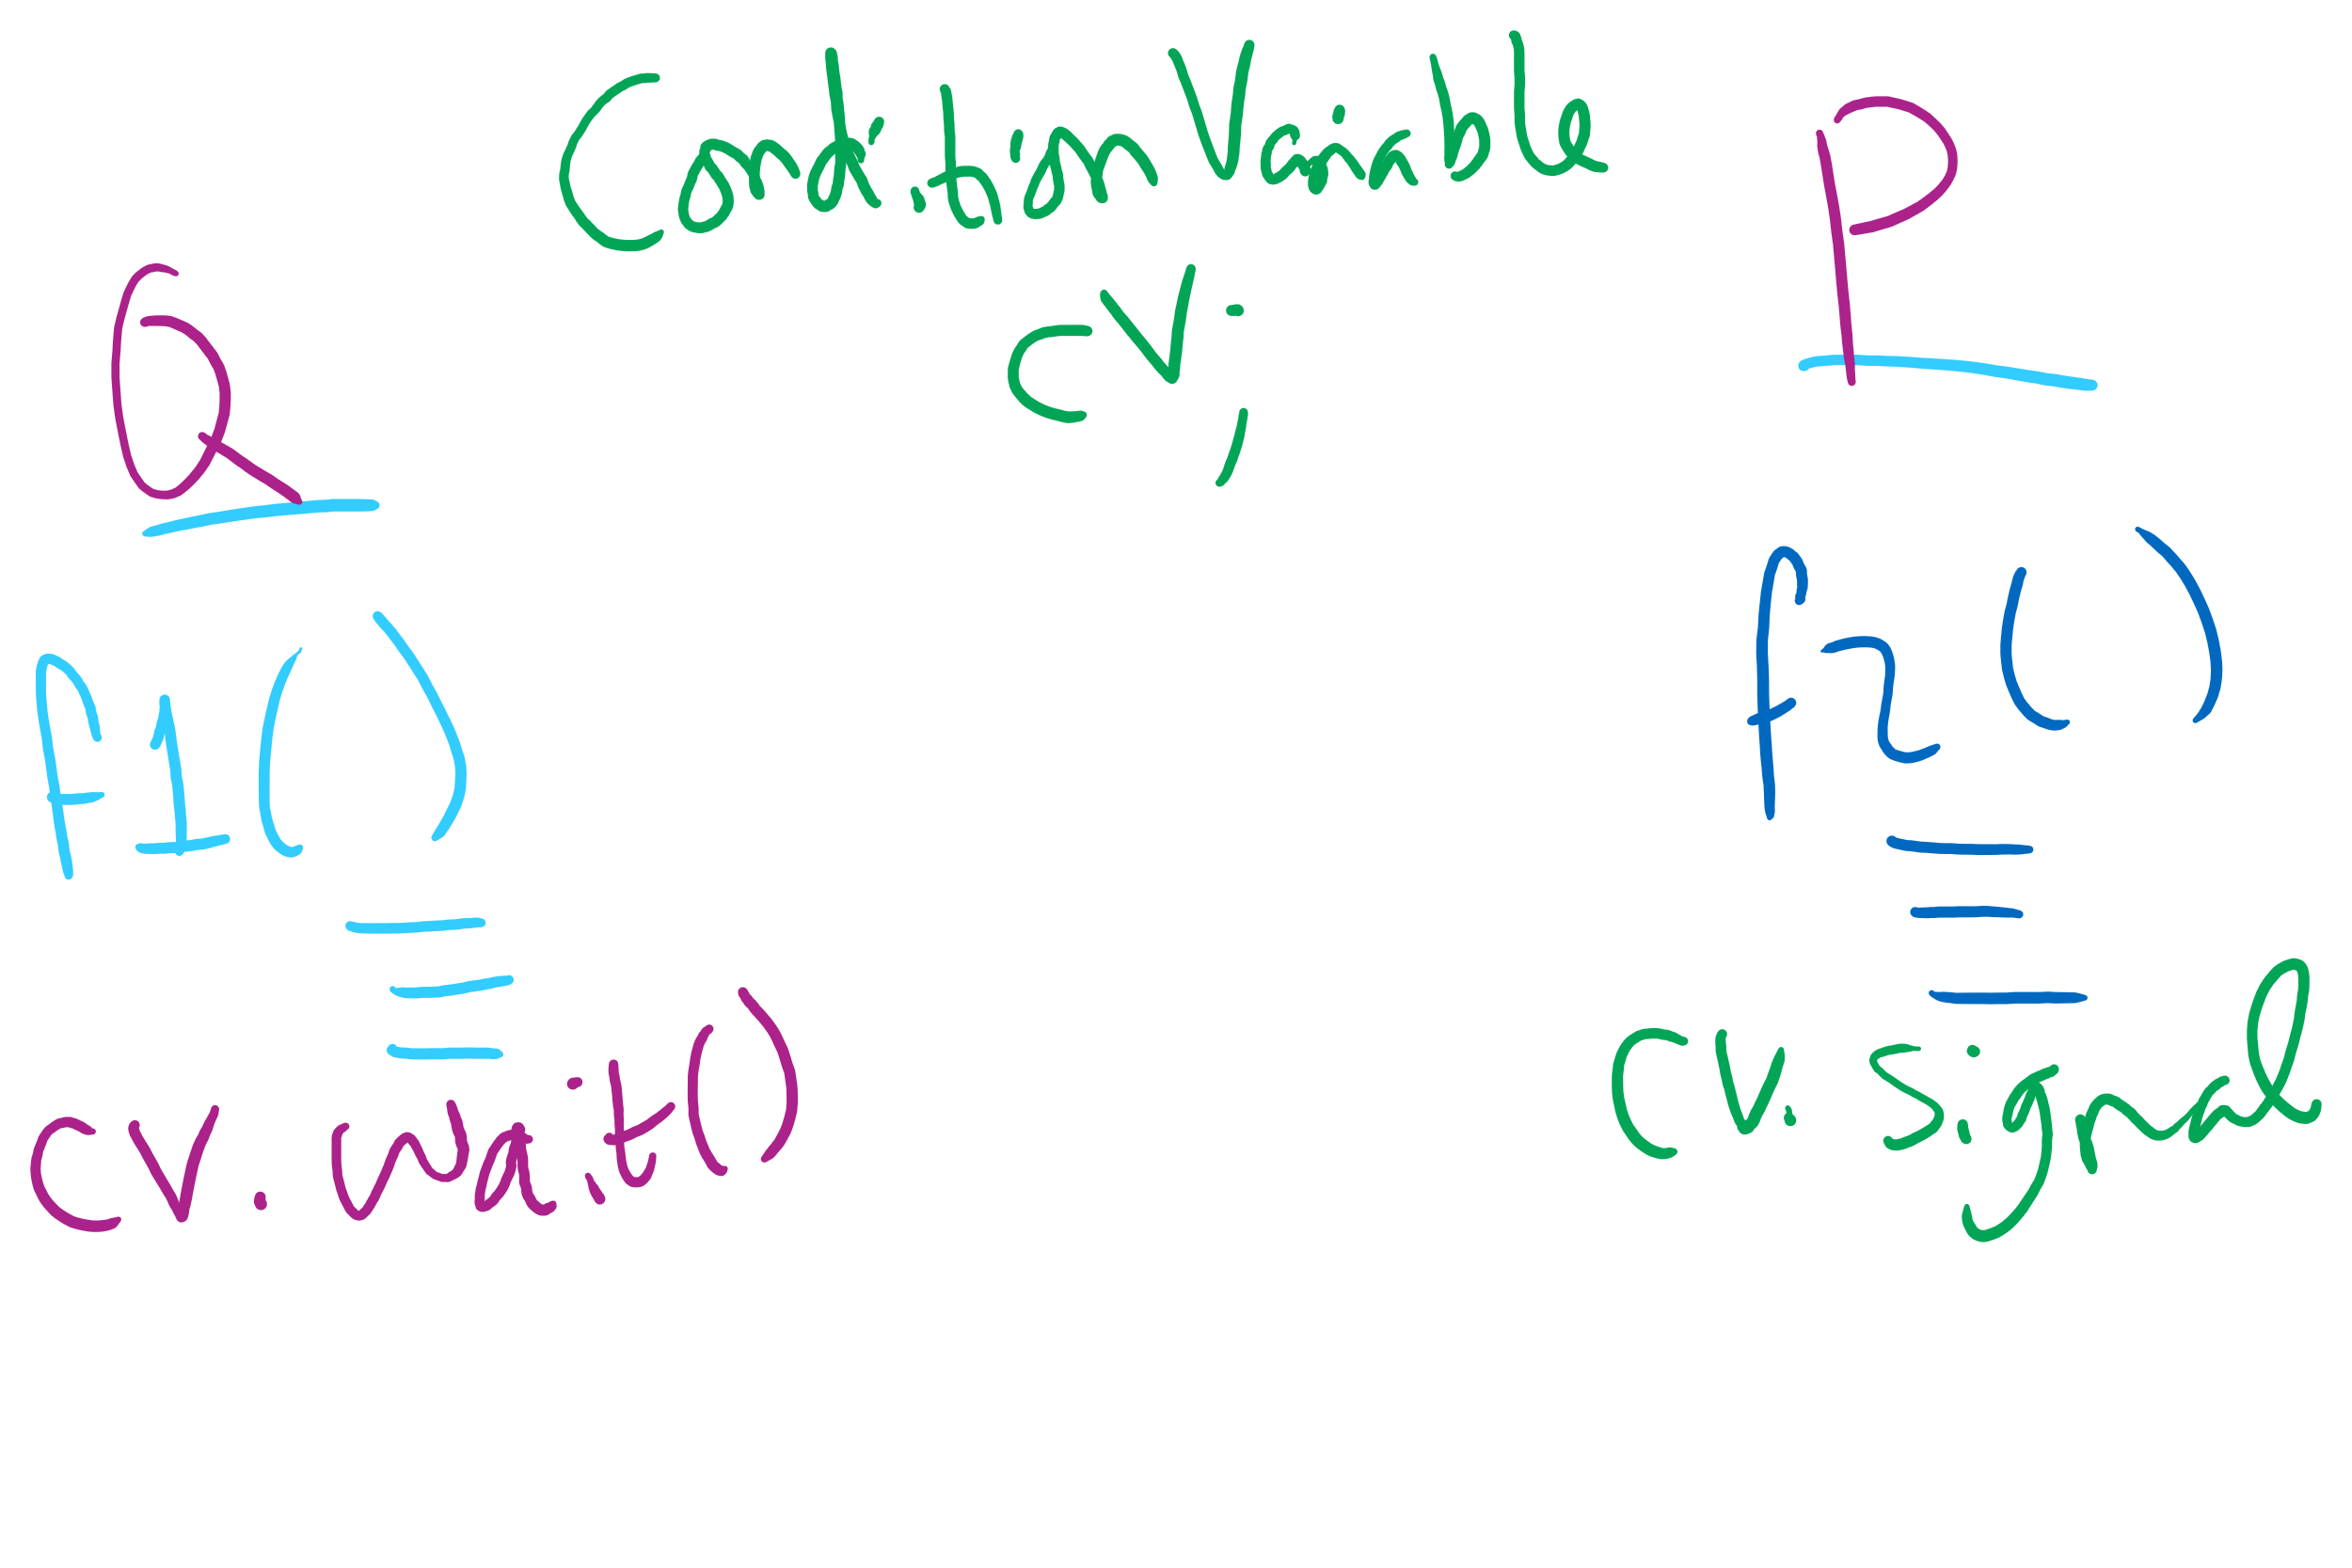
Signaling and Signaled Processes

Slide 12
Condition Variables wait()
Use a while loop around the wait()
While(some condition)
condvar.wait();
Why??
Think Mesa semantics!
Spurious wakeups

Slide 13
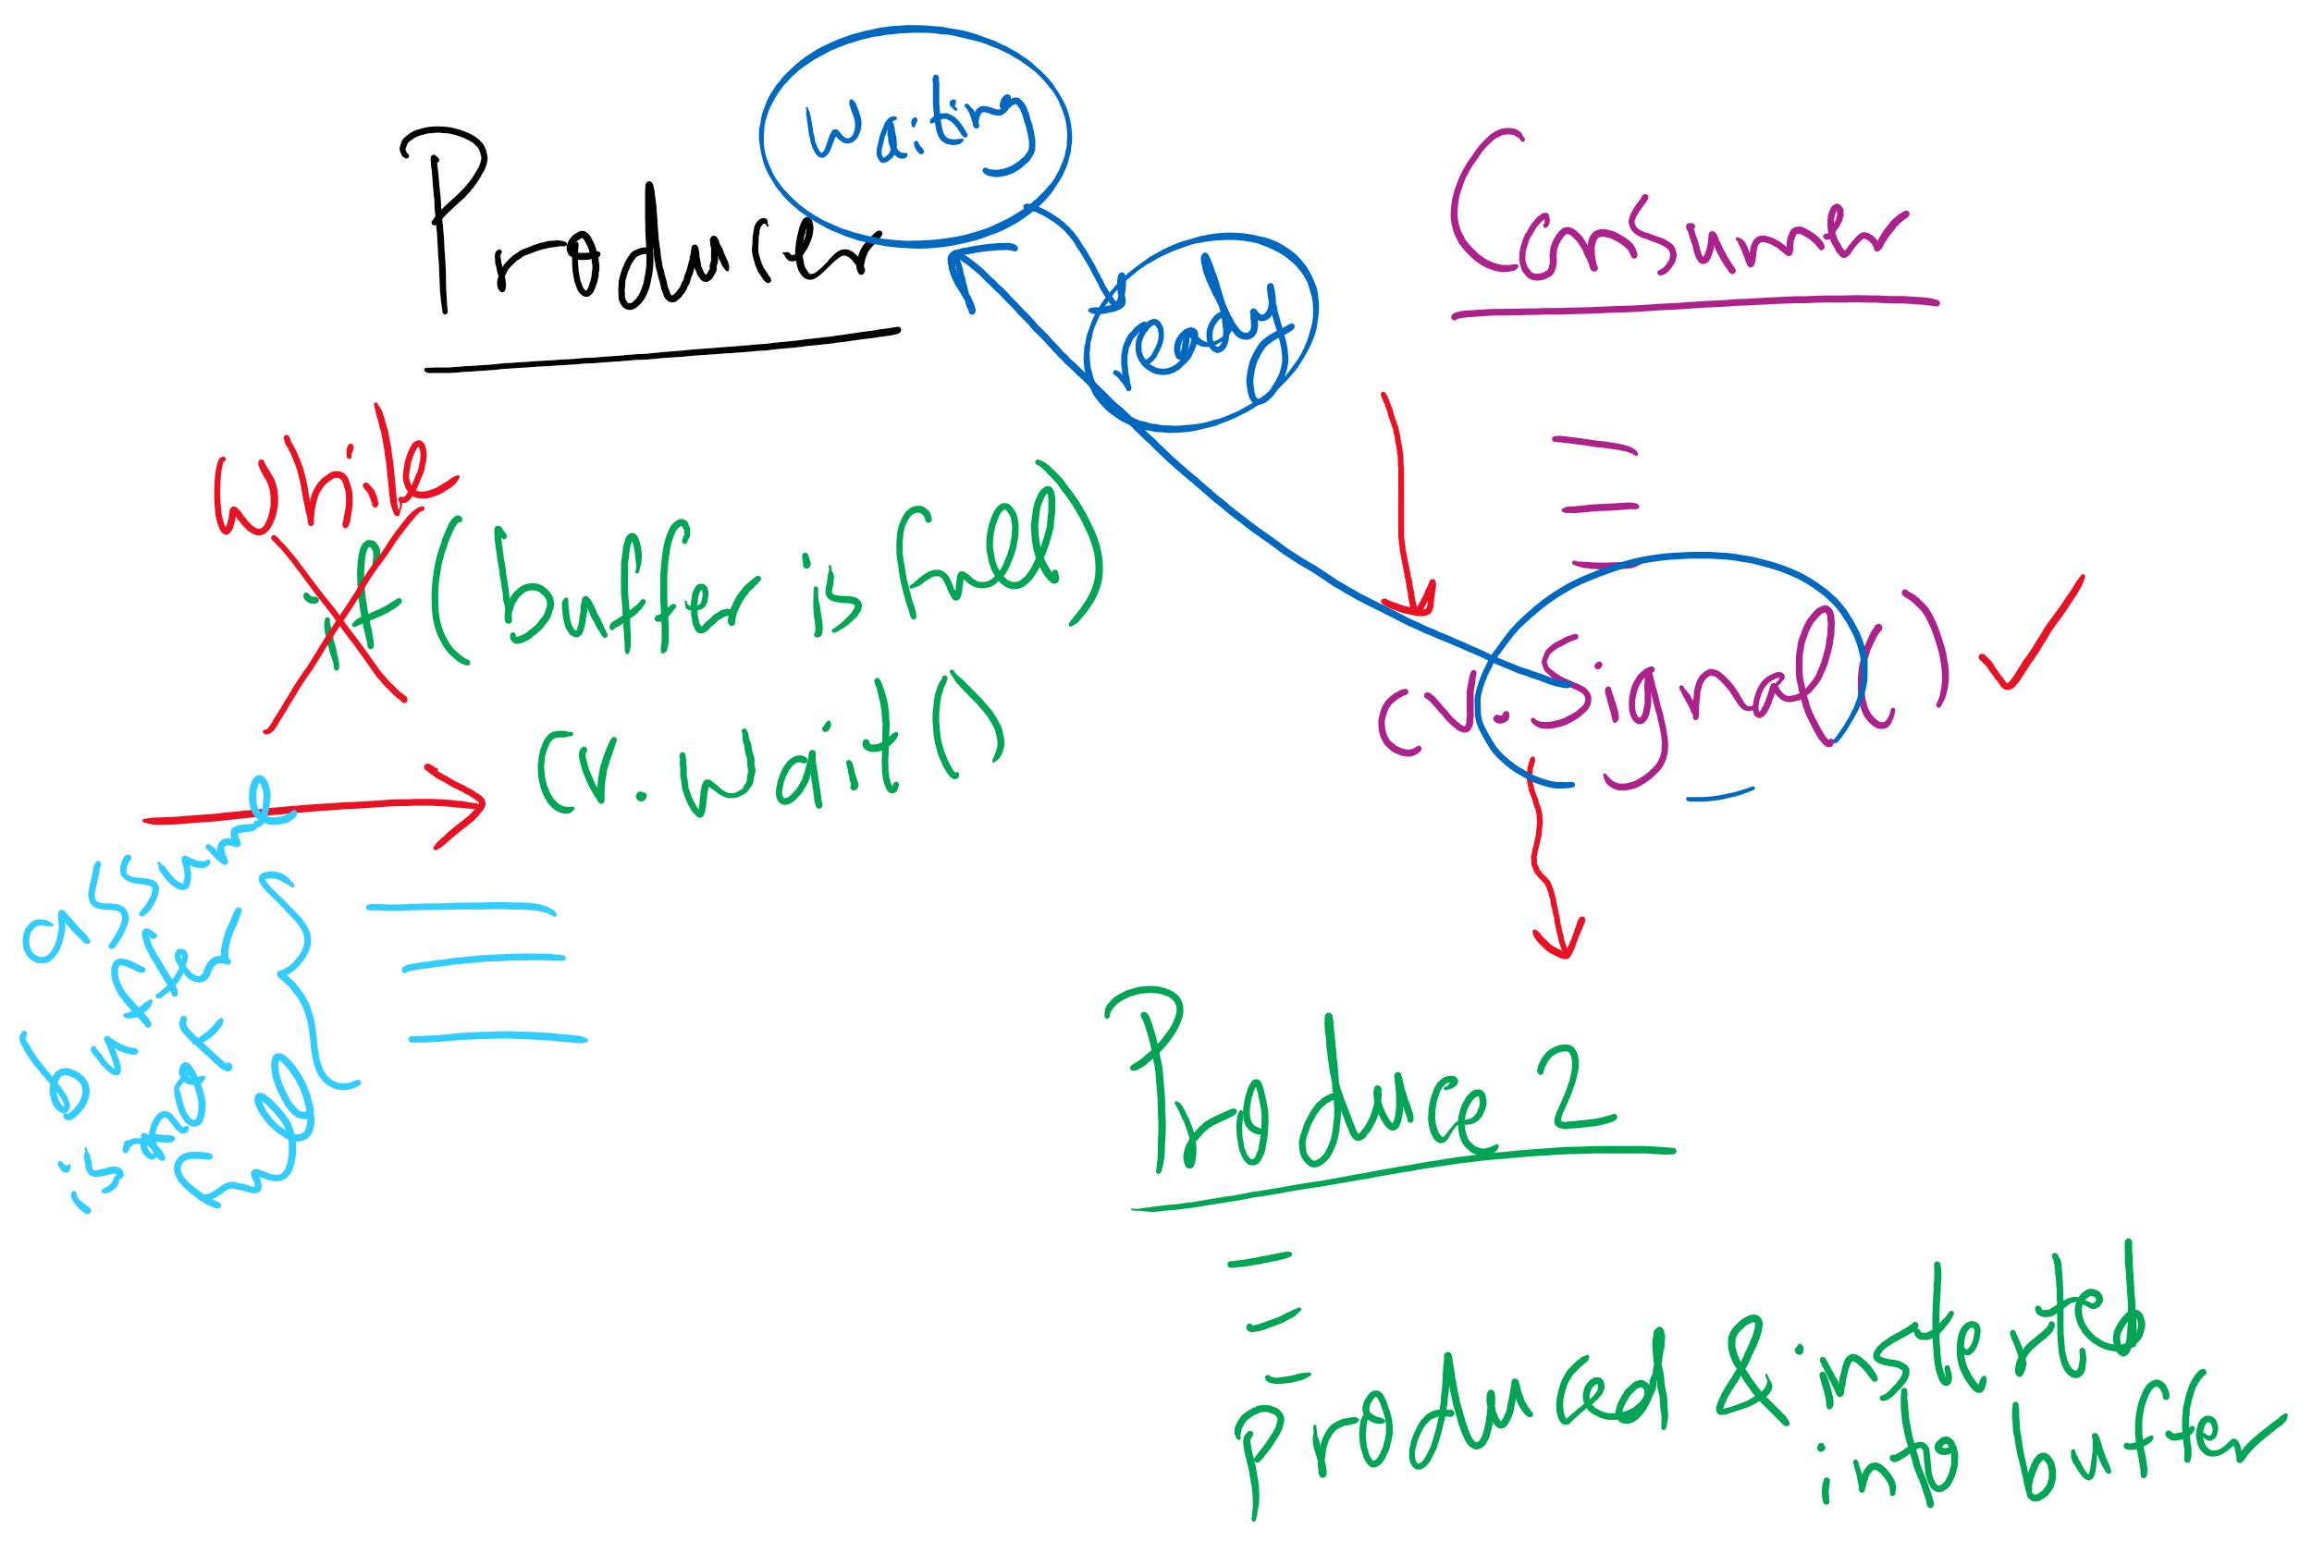
Using while instead of if with wait()

Slide 14
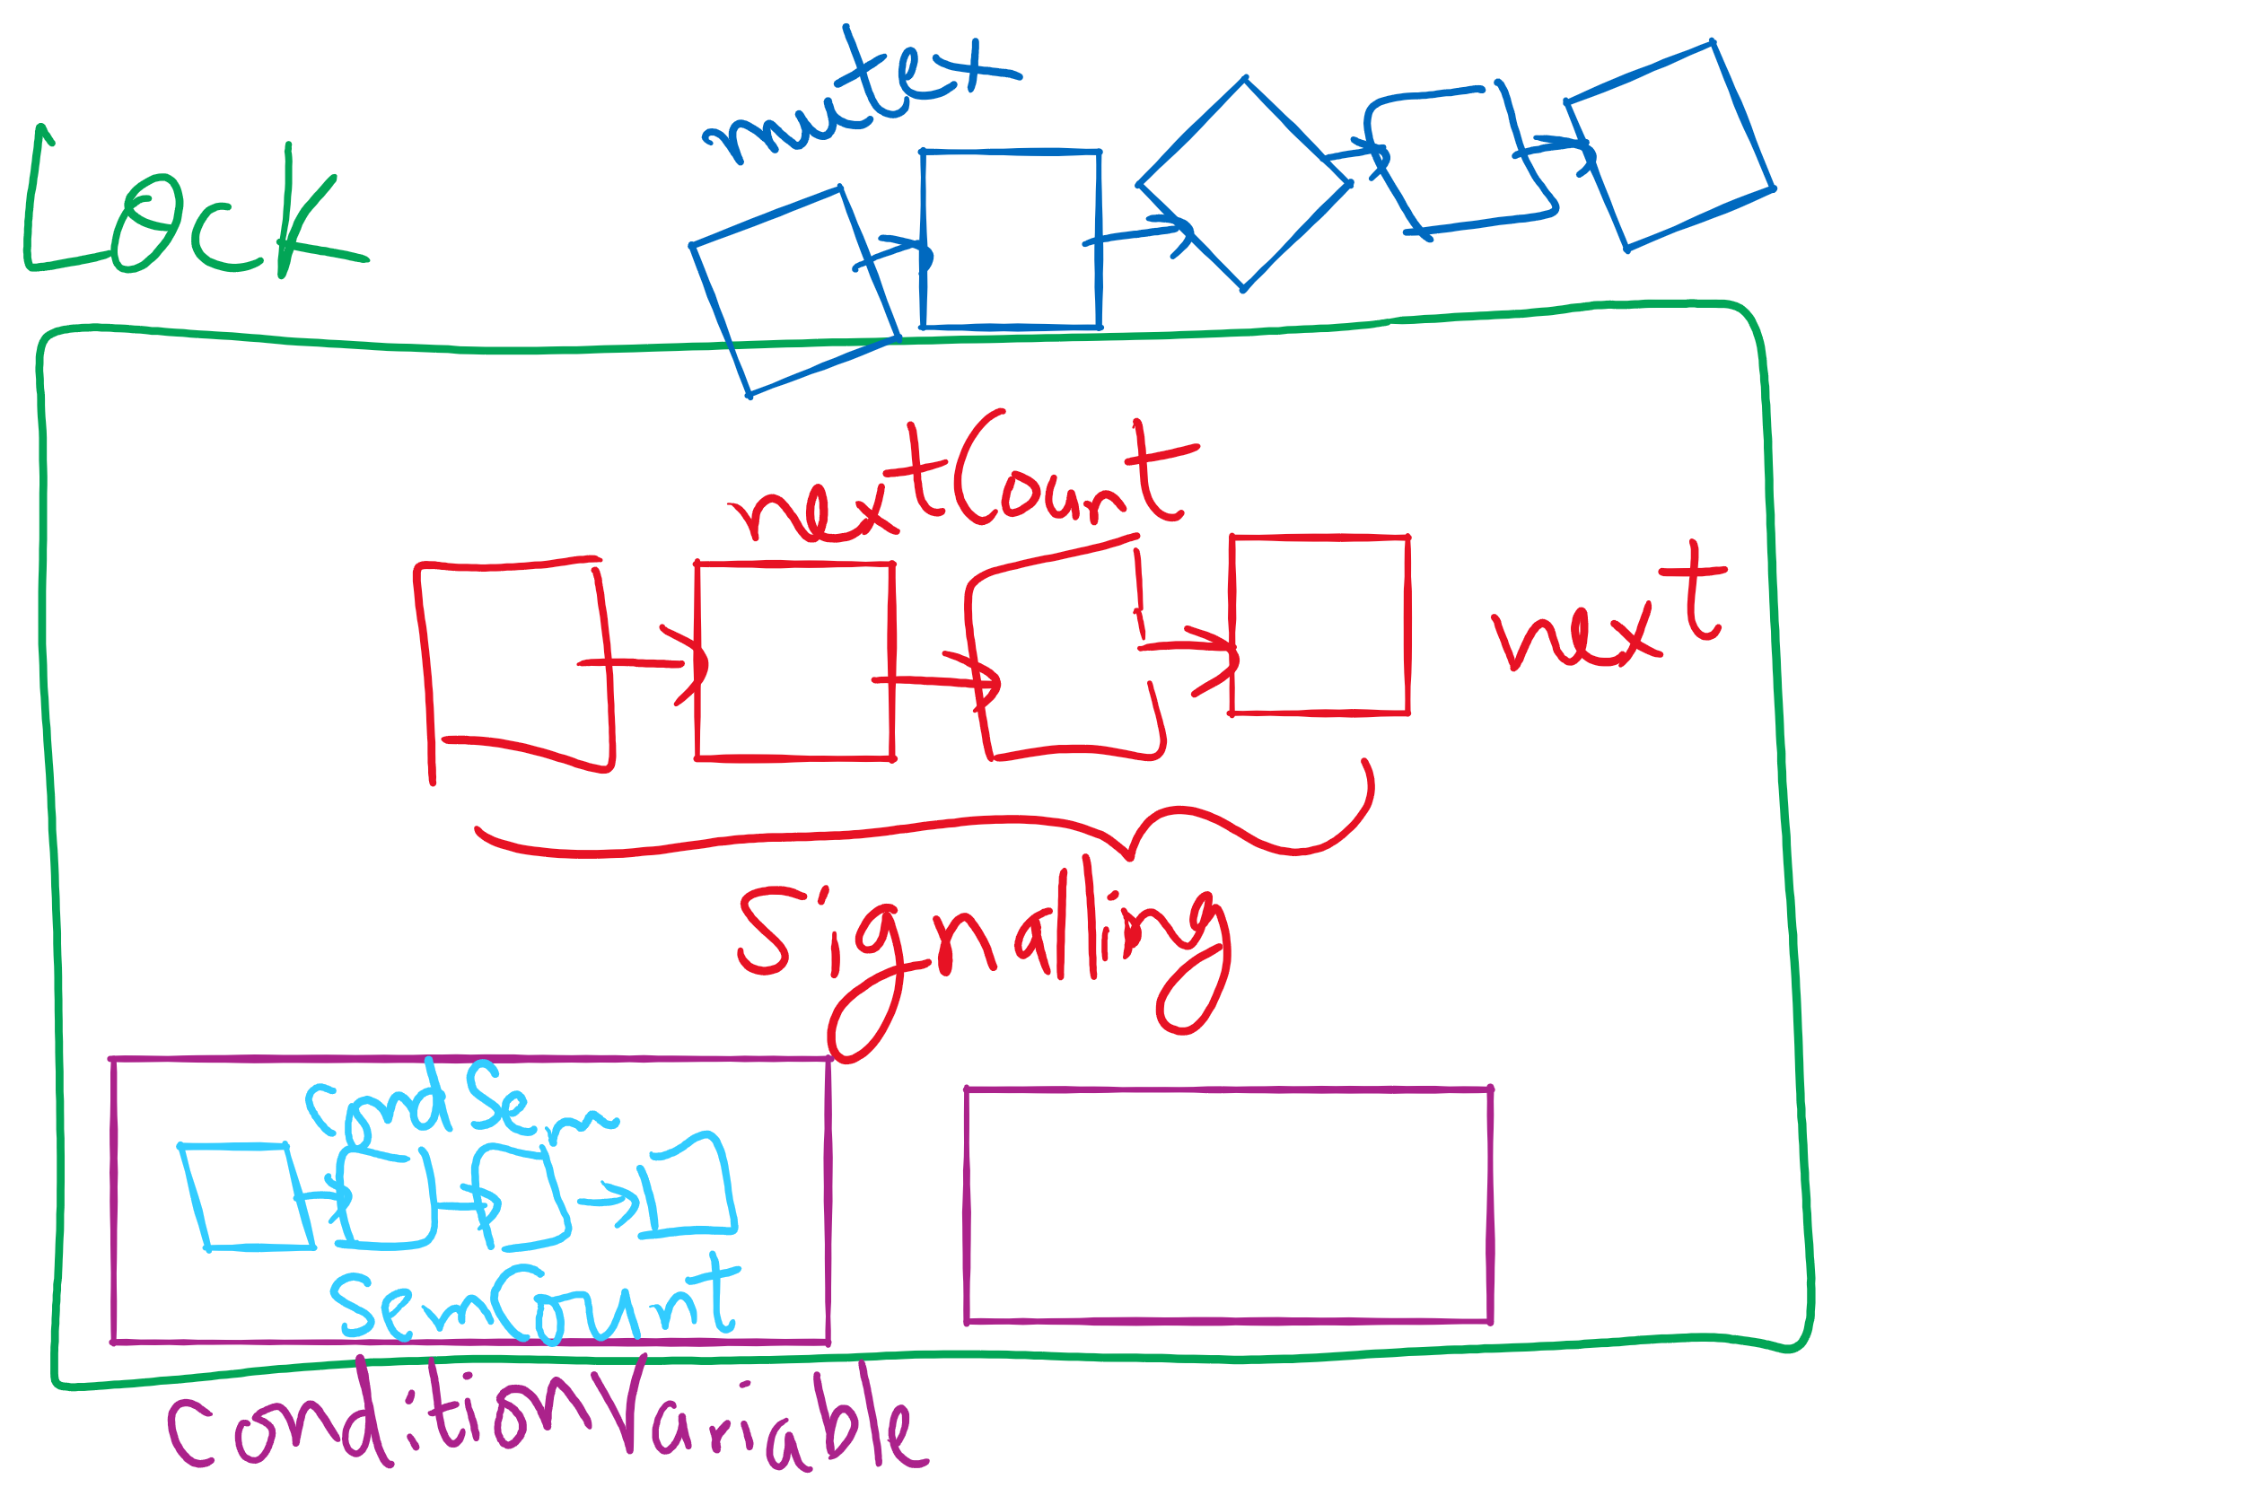
Lock and Condition Variable Implementation

Slide 15
Implementing locks with semaphores
Use mutex to ensure exclusion within the lock bounds
Use next to give lock to processes with a higher priority (why?)
nextCount indicates whether there are any higher priority waiters
class Lock {
Semaphore mutex(1);
Semaphore next(0);
int nextCount = 0;
};
Lock::Acquire()
{
mutex.down();
}
Lock::Release()
{
if (nextCount > 0)
next.up();
else
mutex.up();
}

Slide 16
Implementing condition variables
Are these Hoare or Mesa semantics?
Can there be multiple condition variables for a single Lock?
class Condition {
Lock *lock;
Semaphore condSem(0);
int semCount = 0;
};
Condition::Signal ()
{
if (semCount > 0) {
lock->nextCount += 1;
condSem.up ();
lock->next.down ();
lock->nextCount -= 1;
}
}
Condition::Wait ()
{
semCount += 1;
if (lock->nextCount > 0)
lock->next.up();
else
lock->mutex.up();
condSem.down ();
semCount -= 1;
}

Slide 17
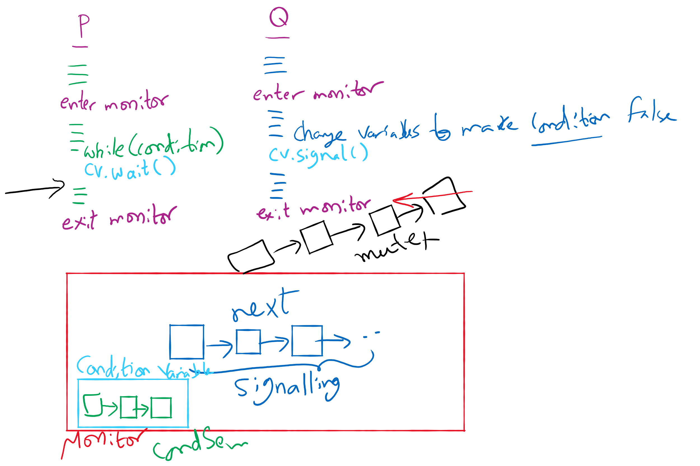
Process Synchronization inside Monitors

Slide 18
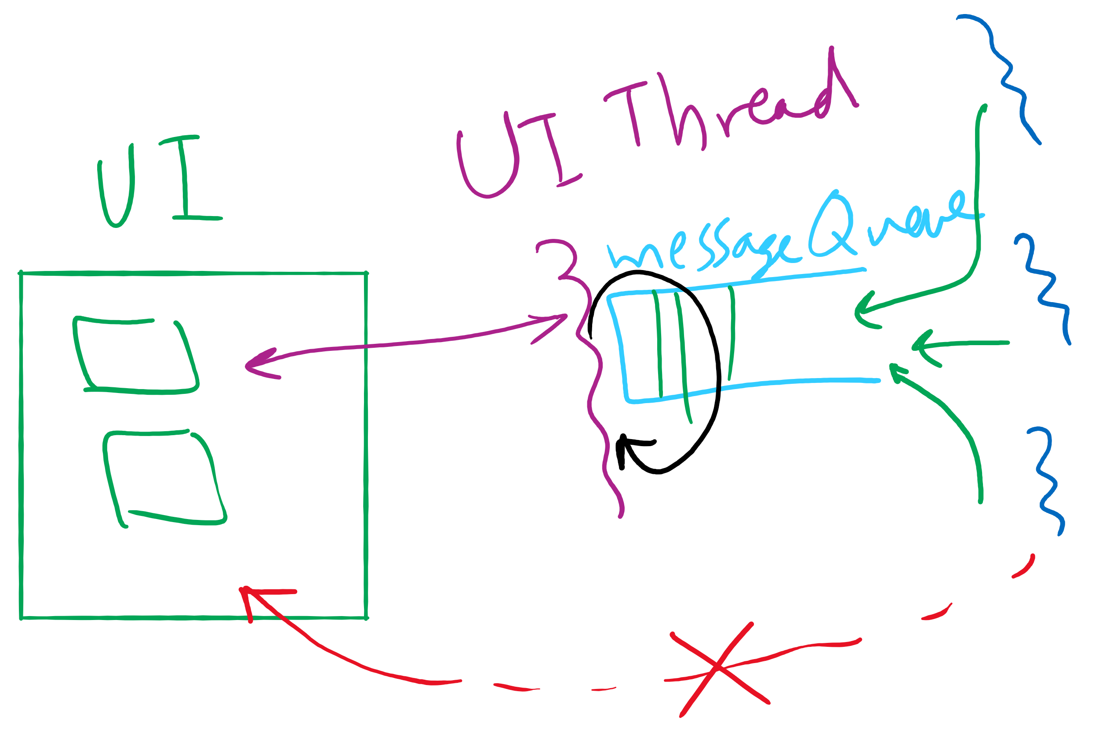
Message passing
Synchronize by exchanging messages
Two primitives:
Send: send a message
Receive: receive a message
Both may specify a “channel” to use
Issue: how does the sender know the receiver got the message?
Issue: authentication

Slide 19
Barriers
Used for synchronizing multiple processes
Processes wait at a “barrier” until all in the group arrive
After all have arrived, all processes can proceed
May be implemented using locks and condition variables
A
A
A
A
B
B
B
B
C
C
C
C
D
D
D
D
Processes approaching
barrier
B and D at
barrier
All at
barrier
Barrier releases all processes

Slide 20
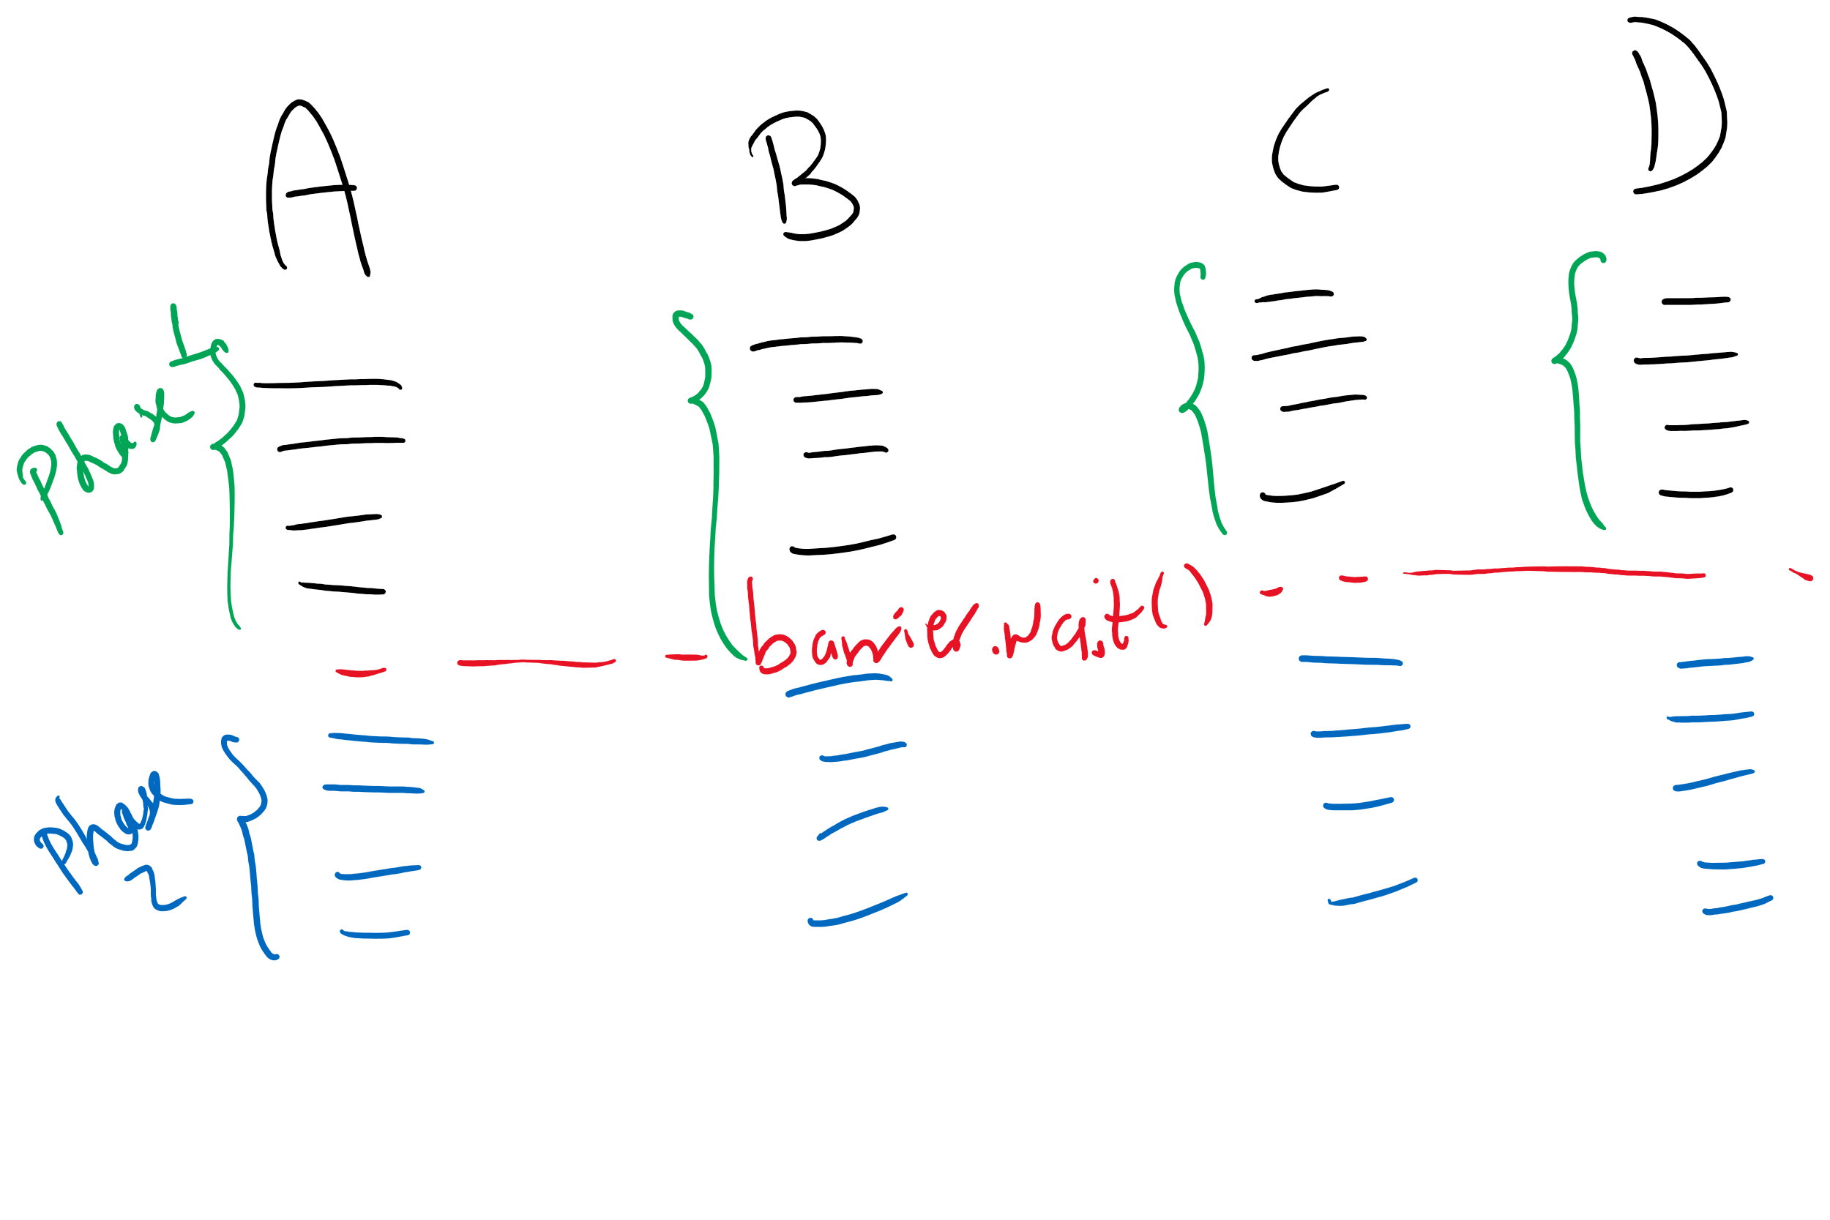
Barriers Example

Slide 21
Xv6 Walkthrough
sleep and wakeup

Slide 22
Classical synchronization problems
Bounded Buffer
Multiple producers and consumers
Synchronize access to shared buffer
Readers & Writers
Many processes that may read and/or write
Only one writer allowed at any time
Many readers allowed, but not while a process is writing
Dining Philosophers
Resource allocation problem
N processes and limited resources to perform sequence of tasks
Goal 1: use semaphores to implement solutions to these problems
Goal 2: use locks and condition variables to implement solutions to these problems

Slide 23
Bounded buffer problem
Goal: implement producer-consumer without busy waiting

Slide 24
Thread spawning

Slide 25
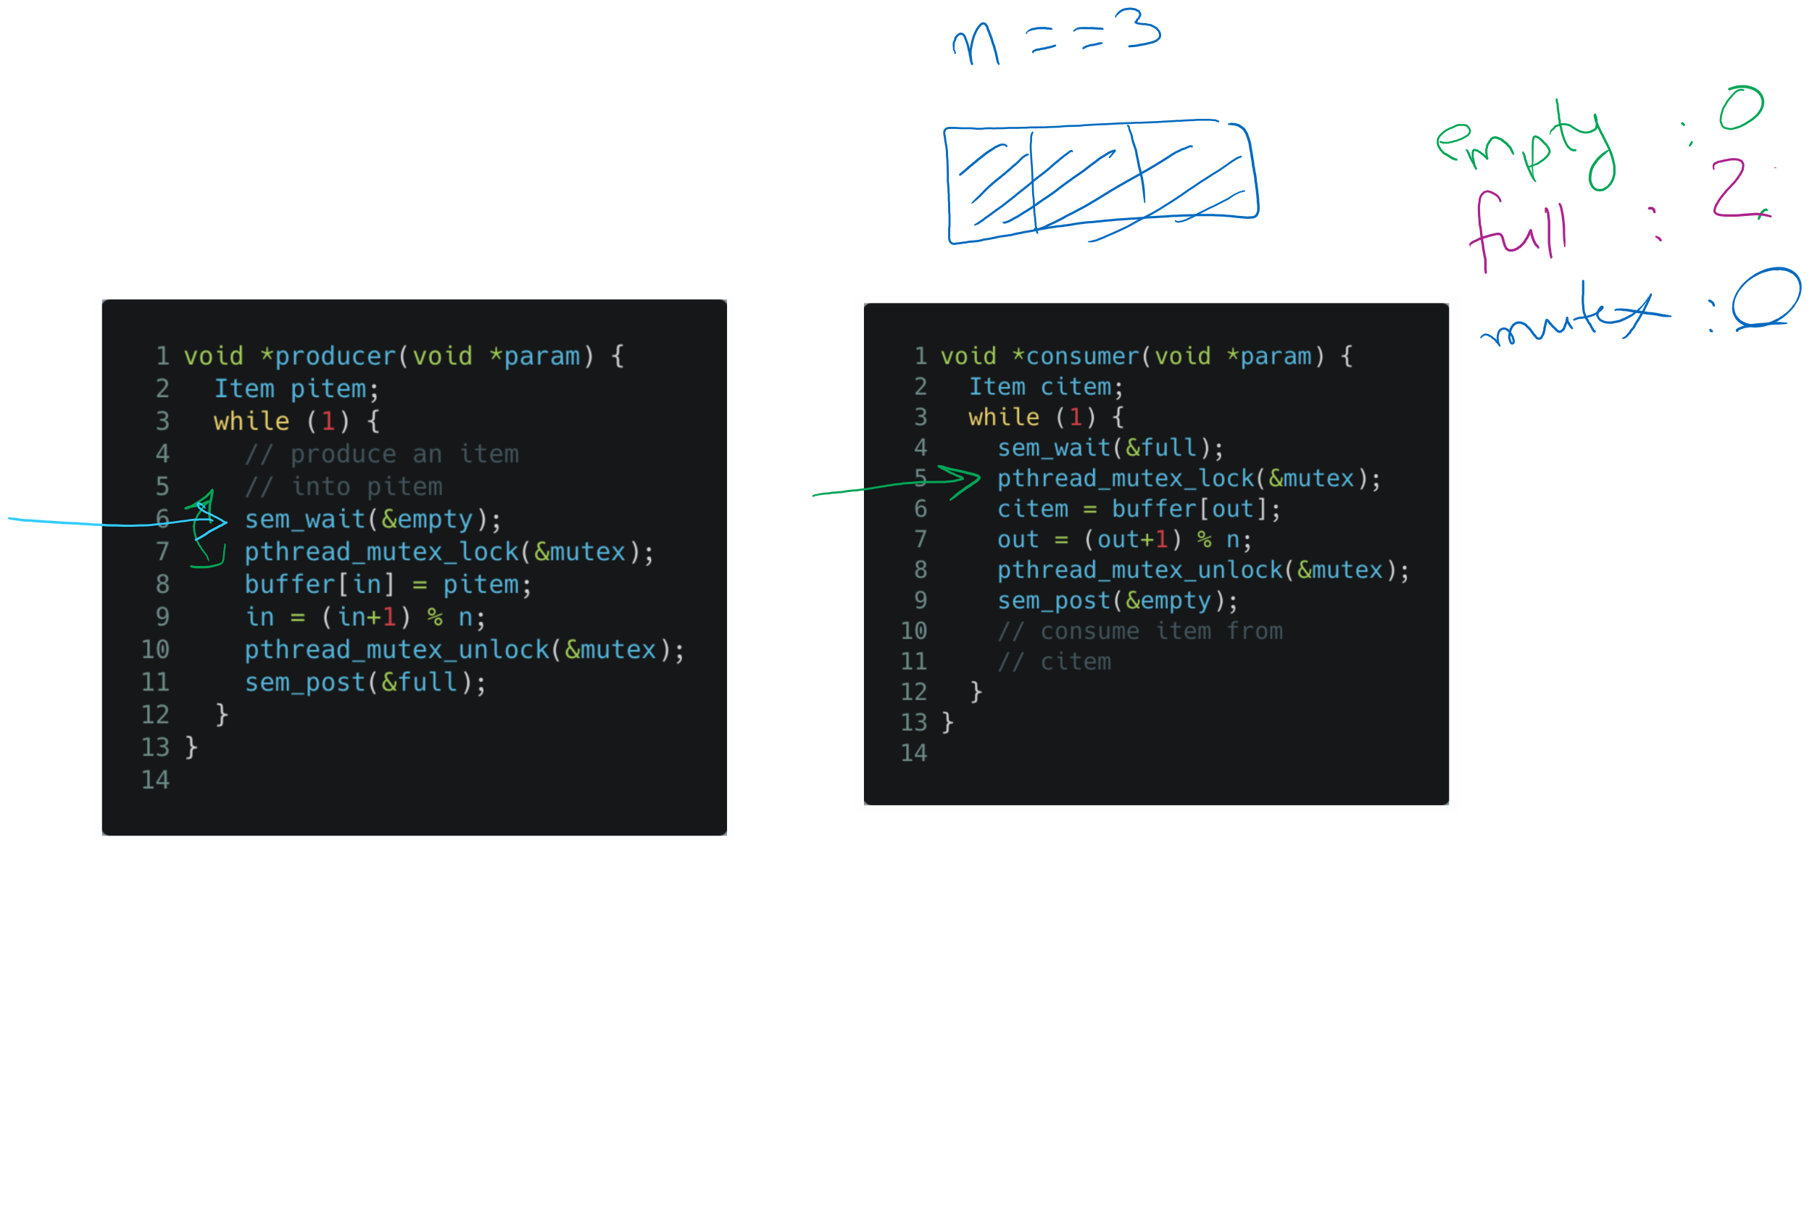
Tracing the solution

Slide 26
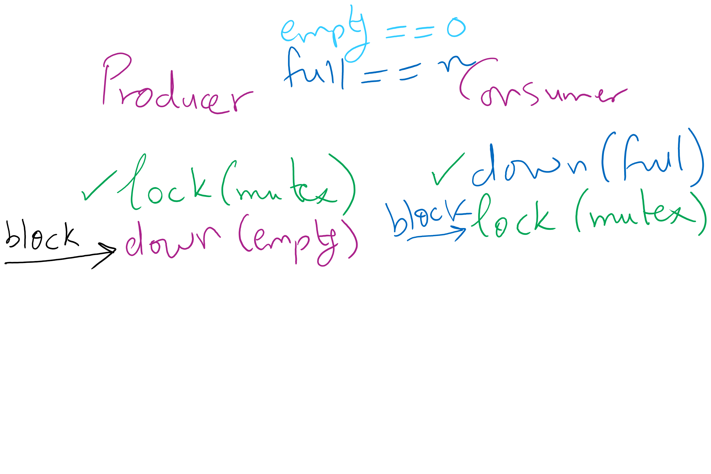
Deadlock can happen with a small mistake

Slide 27
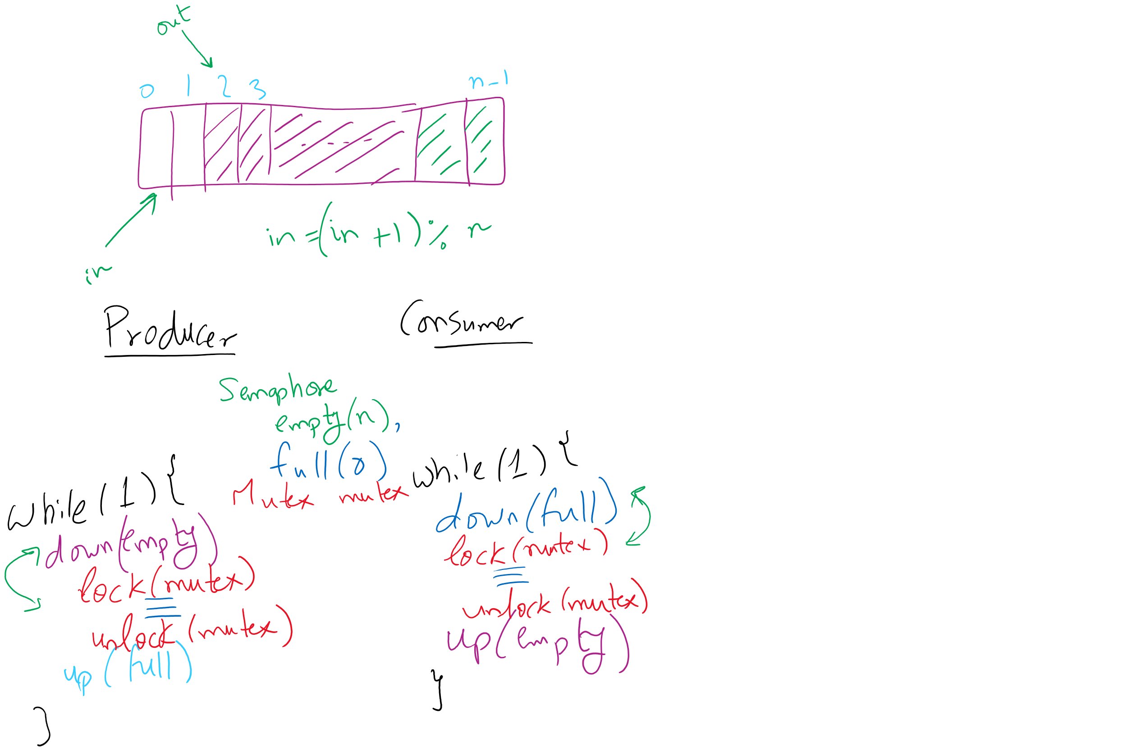
Bounded Buffer (Another rundown)

Slide 28
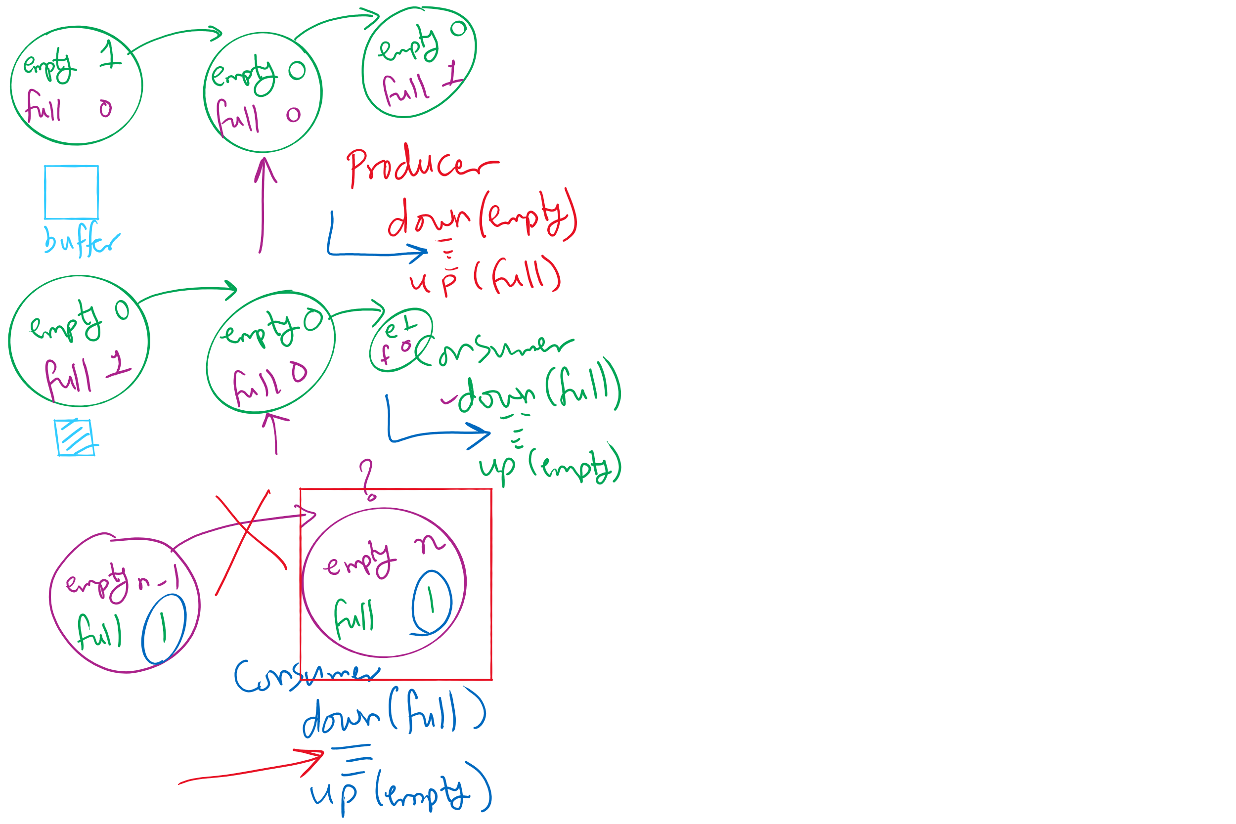
Possible states in Bounded Buffer Solution

